Slide 1
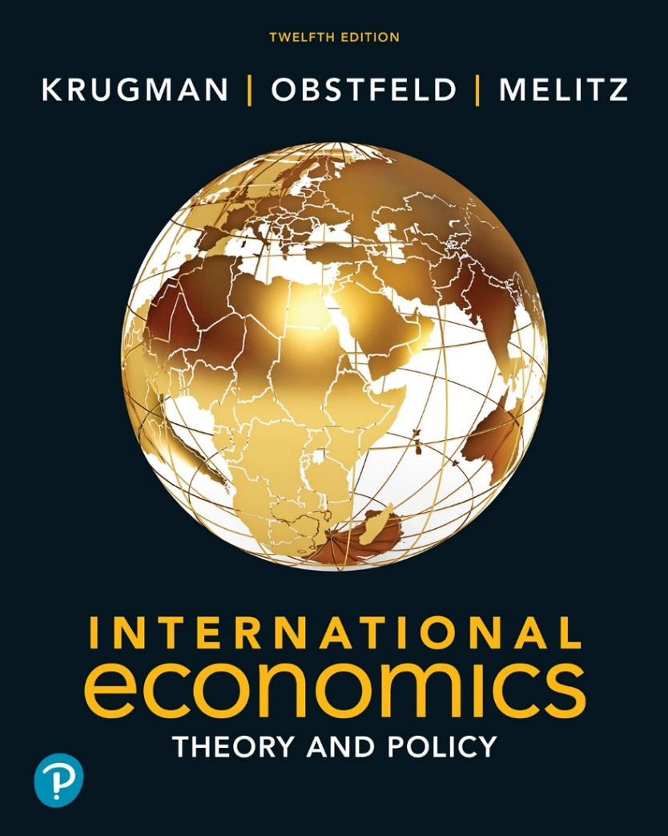

International Economics: Theory and Policy
Twelfth Edition
Chapter 11
Trade Policy in Developing Countries
Copyright © 2022, 2018, 2015 Pearson Education, Inc. All Rights Reserved
Notes:
If this PowerPoint presentation contains mathematical equations, you may need to check that your computer has the following installed:
1) MathType Plugin
2) Math Player (free versions available)
3) NVDA Reader (free versions available)
Slides in this presentation contain hyperlinks. JAWS users should be able to get a list of links by using INSERT+F7

Slide 2
Learning Objectives
11.1 Recapitulate the case for protectionism as it has been historically practiced in developing countries and discuss import-substitution-led industrialization and the “infant industry” argument.
11.2 Summarize the basic ideas behind “economic dualism” and its relationship to international trade.
11.3 Discuss the recent economic history of the Asian countries, such as China and India, and detail the relationship between their rapid economic growth and their participation in international trade.

Slide 3
Preview
Import-substituting industrialization
Trade liberalization since 1985
Trade and growth: takeoff in Asia

Slide 4
Introduction
Which countries are “developing countries”?
The term “developing countries” does not have a precise definition, but it is a name given to many low- and middle-income countries.

Slide 5
Table 11.1 Gross Domestic Product per Capita, 2019 (Dollars, Adjusted for Differences in Price Levels)
United States | 64,747
Germany | 55,110
Japan | 43,445
South Korea | 44,203
Mexico | 21,294
China | 13,548
Bangladesh | 4,513
Source: Conference Board Total Economy Database.

Slide 6
Import-Substituting Industrialization (1 of 4)
Import-substituting industrialization was a trade policy adopted by many low- and middle-income countries before the 1980s.
The policy aimed to encourage domestic industries by limiting competing imports.

Slide 7
Table 11.2 Effective Protection of Manufacturing in Some Developing Countries (Percent)
Mexico (1960) | 26
Philippines (1965) | 61
Brazil (1966) | 113
Chile (1961) | 182
Pakistan (1963) | 271
Source: Bela Balassa, The Structure of Protection in Developing Countries (Baltimore: Johns Hopkins Press, 1971), p. 82.

Slide 8
Import-Substituting Industrialization (2 of 4)
The principal justification of this policy was/is the infant industry argument:
Countries may have a potential comparative advantage in some industries, but these industries cannot initially compete with well-established industries in other countries.
To allow these industries to establish themselves, governments should temporarily support them until they have grown strong enough to compete internationally.

Slide 9
Problems with the Infant Industry Argument
It may be wasteful to support industries now that will have a comparative advantage in the future.
With protection, infant industries may never “grow up” or become competitive.
There is no justification for government intervention unless there is a market failure that prevents the private sector from investing in the infant industry.

Slide 10
Infant Industries and Market Failures (1 of 2)
Two arguments for how market failures prevent infant industries from becoming competitive:
Imperfect financial asset markets
Because of poorly working financial laws and markets (and more generally, a lack of property rights), firms cannot or do not save and borrow to invest sufficiently in their production processes.
If creating better functioning markets and enforcing laws is not feasible, then high tariffs would be a second-best policy to increase profits in new industries, leading to more rapid growth.

Slide 11
Infant Industries and Market Failures (2 of 2)
The problem of appropriability
Firms may not be able to privately appropriate the benefits of their investment in new industries because those benefits are public goods.
The knowledge created when starting an industry may not be appropriable (may be a public good) because of a lack of property rights.
If establishing a system of property rights is not feasible, then high tariffs would be a second-best policy to encourage growth in new industries.

Slide 12
Import-Substituting Industrialization (3 of 4)
Import-substituting industrialization in Latin American countries worked to encourage manufacturing industries in the 1950s and 1960s.
But economic development, not encouraging manufacturing, was the ultimate goal of the policy.
Did import-substituting industrialization promote economic development?
No, countries adopting these policies grew more slowly than others.

Slide 13
Import-Substituting Industrialization (4 of 4)
It appeared that the infant industry argument was not as valid as some had initially believed.
New industries did not become competitive despite or because of trade restrictions.
Import-substitution industrialization involved costs and promoted wasteful use of resources:
It involved complex, time-consuming regulations.
It set high tariff rates for consumers, including firms that needed to buy imported inputs for their products.
It promoted inefficiently small industries.

Slide 14
Trade Liberalization (1 of 4)
Some low- and middle-income countries that had relatively free trade had higher average economic growth than those that followed import substitution.
By the mid-1980s, many governments had lost faith in import substitution and began to liberalize trade.
Dramatic fall in tariff rates in India and Brazil, and less drastic reductions in many other developing countries.

Slide 15
Trade Liberalization (2 of 4)
Trade liberalization in developing countries occurred along with a dramatic increase in the volume of trade.
The share of trade in G D P has tripled over 1970–1998, with most of the growth happening after 1985.
The share of manufactured goods in developing-country exports surged, coming to dominate the exports of the biggest developing economies.
A number of developing countries have achieved extraordinary growth while becoming more, not less, open to trade.

Slide 16
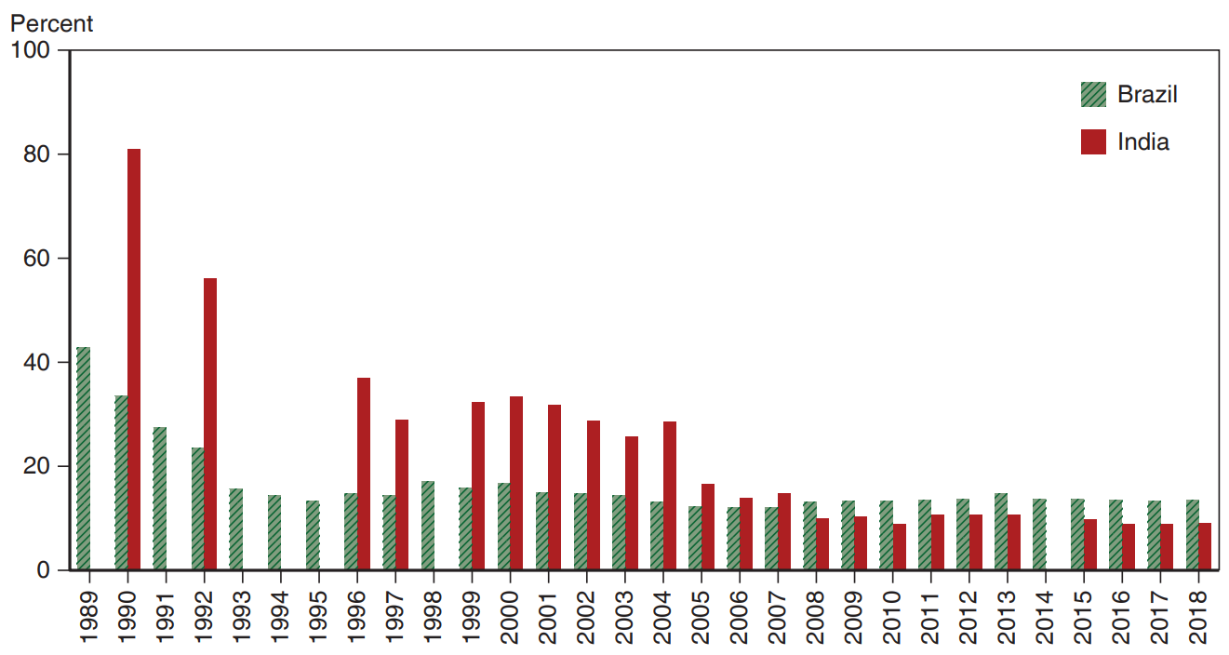
Figure 11.1 Tariff Rates in Developing Countries
One measure of the shift away from import-substituting industrialization is the sharp drop in tariff rates in developing countries, which have fallen from an average of more than 30 percent in the early 1980s to only about 10 percent today. Countries that once had especially strong import-substitution policies, like India and Brazil, have also seen the steepest declines in tariff rates.
Source: World Bank.
Notes:
The bar graph depicts percentage versus decades, 19 89 to 20 18. From 19 89 to 19 95, the traffic rates in Brazil generally fall from 42% to 15%. From 19 96 to 19 98 the percentage rose each decade from 15% to 18%. In 19 98, it started to fall again each decade, from 18% to 11% in 20 07. From 20 07, the percentage rose to 14%, in 20 13 and then fell to 11%, in 20 18. From 19 90 to 19 97, the tariff rates in India generally fall from 82% to 30%. From 19 97 to 20 00, the percentage rose each decade from 30% to 35%. In 20 01, it started to fall again each decade, from 34% to 30% in 20 03. In 20 04, the tariff rate rose to 30% and fell again to from 20 05 to 20 18, at 10%. All values are estimated.

Slide 17
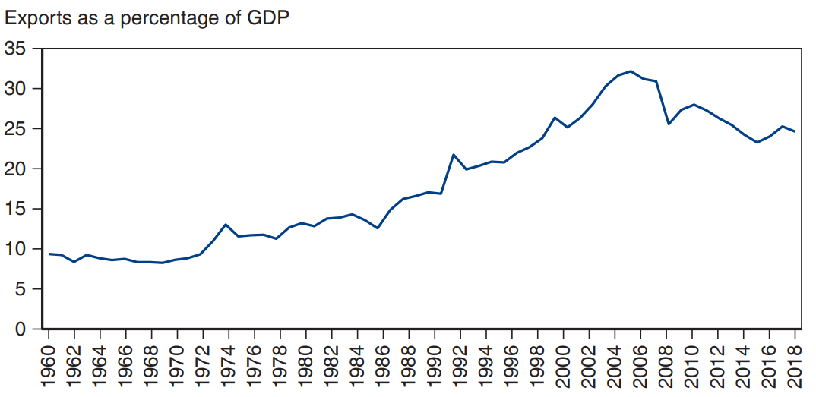
Figure 11.2 The Growth of Developing-Country Trade
Beginning in the 1980s, many developing countries began shifting away from import-substitution policies. One result has been a large rise in exports as a percentage of G D P.
Source:
http://data.worldbank.org/indicator/NE.EXP.GNFS.ZS
,
http://data.worldbank.org/indicator/NE.IMP.GNFS.ZS
Notes:
The graph plots the Exports as a percentage of G D P versus year, 19 60 to 20 18. The plot generally rises from (19 60, 9) through (19 74, 12), falls to (19 85, 11), rises through (19 91, 17), to (2005, 31,) and ends at (20 18, 24). All values are estimated.

Slide 18
Trade Liberalization (3 of 4)
Has trade liberalization promoted development? The evidence is mixed.
Growth rates in Brazil and other Latin American countries have been slower since trade liberalization than they were during import-substituting industrialization.
But unstable macroeconomic policies and financial crises contributed to slower growth since the 1980s.

Slide 19
Trade Liberalization (4 of 4)
Other countries like India have grown rapidly since liberalizing trade in the 1980s, but it is unclear to what degree liberalized trade contributed to growth.
Some economists also argue that trade liberalization has contributed to income inequality, as the Heckscher-Ohlin model predicts.

Slide 20
Trade and Growth: Takeoff in Asia (1 of 3)
Instead of import substitution, several countries in East Asia adopted trade policies that promoted exports in targeted industries.
Japan, Hong Kong, Taiwan, South Korea, Singapore, Malaysia, Thailand, Indonesia, and China have experienced rapid growth in various export sectors and rapid economic growth in general.
These high-performance Asian economies generated a high volume of exports and imports relative to total production.

Slide 21
Trade and Growth: Takeoff in Asia (2 of 3)
Their policy reforms were followed by a large increase in openness, as measured by their share of exports in G D P.
So it is possible to develop through export-oriented growth.
However, Latin American nations such as Mexico and Brazil, which also sharply liberalized trade and shifted toward exports, did not see comparable economic takeoffs.
These Latin American results suggest that other factors must have played a crucial role in the Asian miracle.

Slide 22
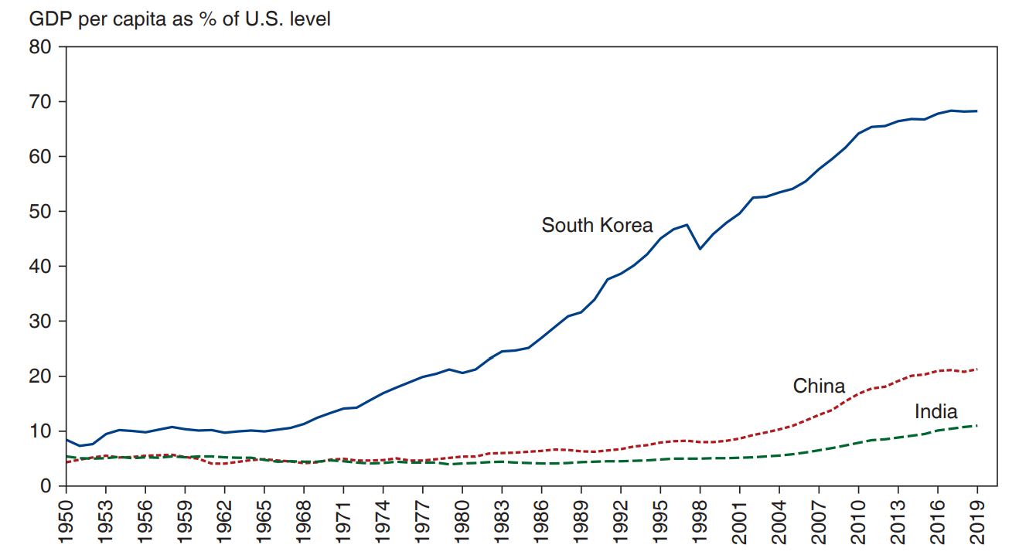
Figure 11.3 The Asian Takeoff
Beginning in the 1960s, a series of economies began converging on advanced-country levels of income. Here we show G D P per capita as a percentage of its level in the United States, using a proportional scale to highlight the changes. South Korea began its ascent in the 1960s, China at the end of the 1970s, and India about a decade later.
Source: Total Economy Database.
Notes:
A triple line graph plots the G D P per capita as a percent of the U S level versus year, 19 50 to 20 13, for South Korea, China and India. The plot for South Korea generally rises from (19 50, 8) though (19 96, 46) and (20 19, 68). The plot for China generally rises from (19 50, 5) through (19 96, 7) to (20 19, 19). The plot for India generally rises from (19 50, 3) through (19 96, 5) to (20 19, 9). All values are estimated.

Slide 23
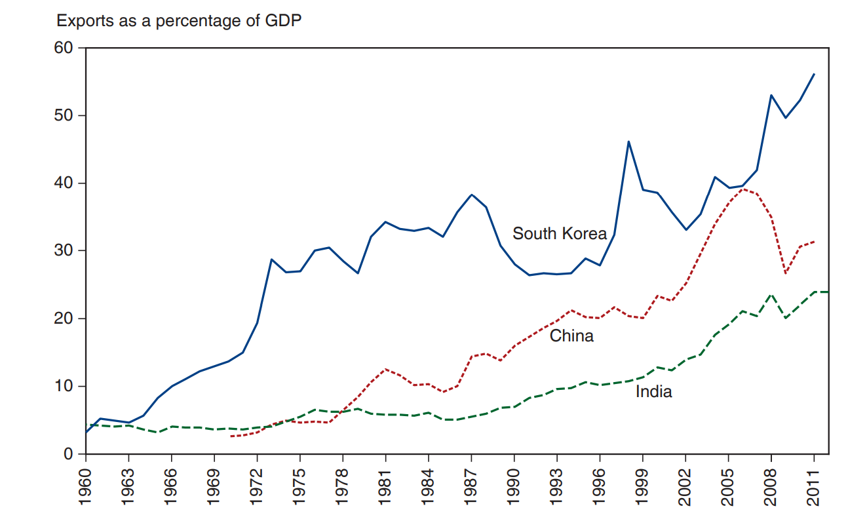
Figure 11.4 Asia’s Surging Trade
Source: World Bank
Notes:
A triple line graph plots exports as a percentage of G D P versus year, 19 60 to 20 11, for South Korea, China and India. The plot for South Korea generally rises from (19 63, 5) to (19 87, 38), dips to (19 93, 25), then generally rises to (20 11, 57). The plot for China generally rises from (19 70, 3) through (20 01, 22), then rises to (20 06, 38), dips to (20 09, 28), and rises to (20 11, 32). The plot for India generally rises from (19 60, 4) through (19 84, 5) to (20 11, 21). All values are estimated.

Slide 24
Trade and Growth: Takeoff in Asia (3 of 3)
It’s unclear if the high volume of exports and imports caused rapid economic growth or was merely correlated with rapid economic growth.
High saving and investment rates could have led to both rapid economic growth in general and rapid economic growth in export sectors.
Rapid growth in education led to high literacy and numeracy rates important for a productive labor force.
These nations also undertook other economic reforms.

Slide 25
Summary (1 of 3)
Import-substituting industrialization aimed to promote economic growth by restricting imports that competed with domestic products in low- and middle-income countries.
The infant industry argument says that new industries need temporary trade protection due to market failures:
imperfect asset markets that restrict saving, borrowing, and investment in production processes
problems of appropriating gains from private investment in production processes

Slide 26
Summary (2 of 3)
Import-substituting industrialization was tried in the 1950s and 1960s but by the mid-1980s it was abandoned for trade liberalization.
The effect of liberalized trade on national welfare is still being debated.
Trade helped growth in some sectors, but saying that trade caused higher overall economic growth has attracted some skepticism.
Some argue that trade has caused increased income inequality.

Slide 27
Summary (3 of 3)
Several East Asian economies adopted export-oriented instead of import-substituting industrialization.
High export and import volumes and relatively low trade restrictions were characteristics of this policy.
It’s unclear to what degree this policy contributed to overall economic growth, especially since other countries have not had similar successes.

Slide 28

Copyright
This work is protected by United States copyright laws and is provided solely for the use of instructors in teaching their courses and assessing student learning. Dissemination or sale of any part of this work (including on the World Wide Web) will destroy the integrity of the work and is not permitted. The work and materials from it should never be made available to students except by instructors using the accompanying text in their classes. All recipients of this work are expected to abide by these restrictions and to honor the intended pedagogical purposes and the needs of other instructors who rely on these materials.

